Slide 1

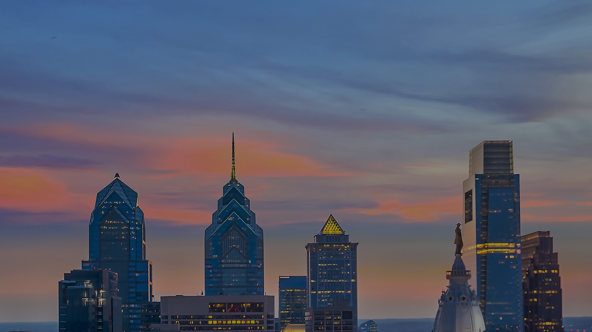
Fine-Tuning BLIP
Fine-Tuning BLIP
Bootstrapping Language-Image Pre-training
to caption images of skylines

Slide 2
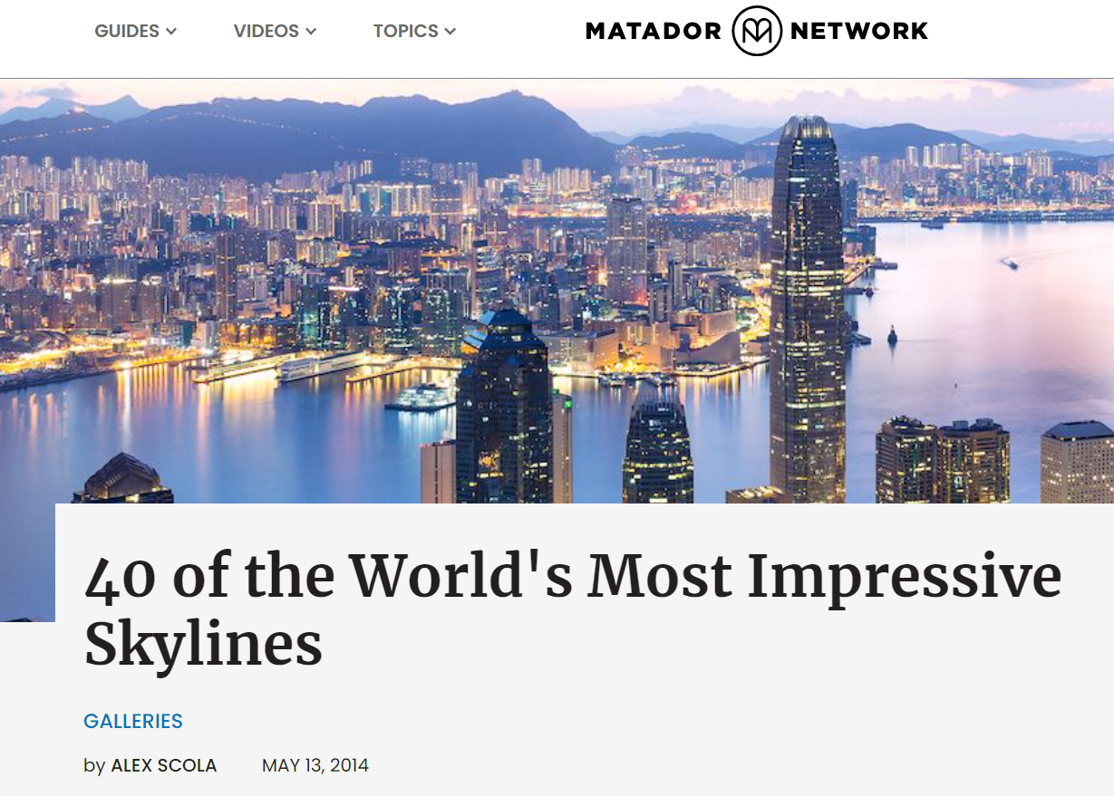
SKYLINES
Interesting mix of similar yet distinct features
Let’s see how the BLIP model performs when fine-tuned on 10 images + captions of each city
Hong Kong
Can the model correctly distinguish the city?
How well does it describe the image?

Slide 3
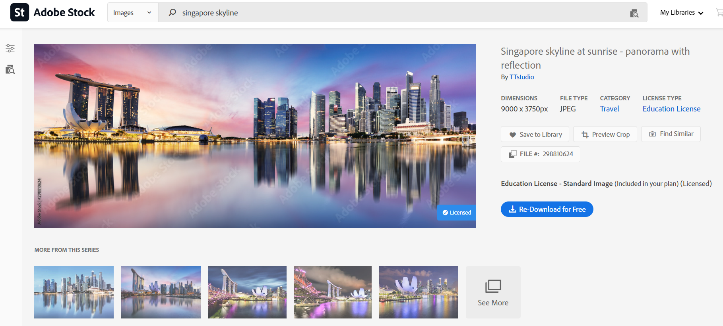
DATA COLLECTION
Captions to fine-tune the model, accessible through the image metadata
~400 Adobe Stock photos with descriptive captions

Slide 4


DATA COLLECTION
What we became curious about
Selection criteria
Variety of angles
Variety of conditions
e.g., sunset/sunrise, foggy, cloudy, night/day
Detailed description, incl. named landmarks
“<city> skyline” captions were avoided
Consistency
moon was rare, so if present it should be mentioned
cloudy vs sunny
For each city, reviewed ~100 photos to select 10

Slide 5
DATA COLLECTION
What we became curious about
Model collapse
It seemed some stock photo captions were AI-generated
How would the model perform with regards to ambiguity
1. Sunrise vs. sunset can be hard to tell from these images
2. Abstract/fuzzy concepts like dusk, dawn, twilight
3. River vs. bay vs. lake vs. sea… Pier vs. port vs. marina… Boat vs. yacht vs. barge vs. ferry…
How would the model perform with prevalent abstract concepts
Reflection and panoramic

Slide 6
Let’s see how our model works

